Slide 1
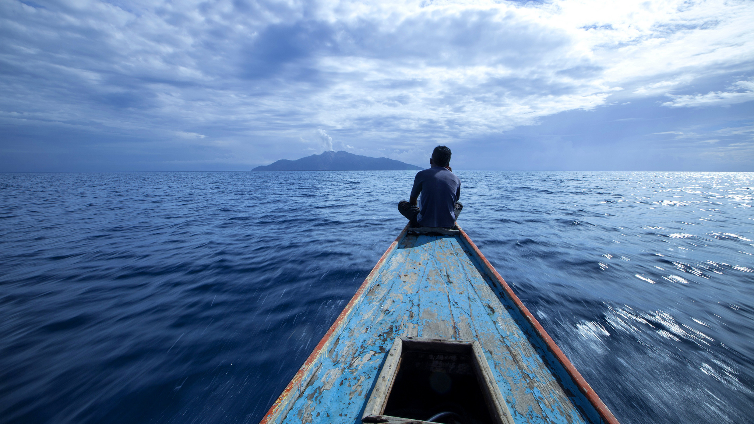
Risk Unseen
A serious game on risk and preparedness
By Dorothy Heinrich and Erin Coughlan de Perez

Slide 2
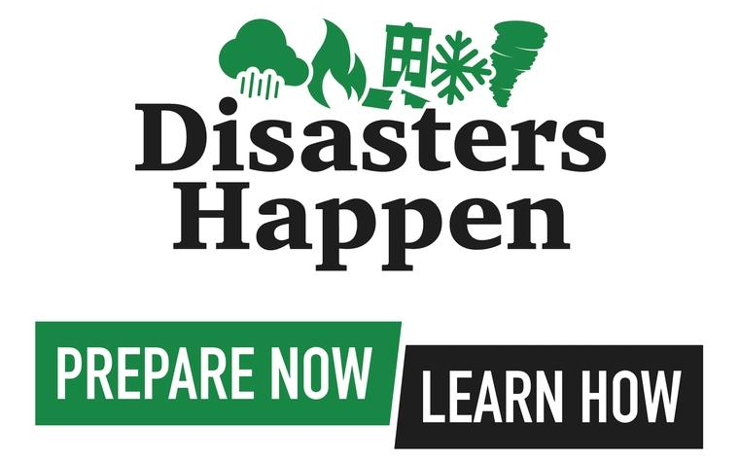
This is a game about preparedness

Slide 3
Welcome to Madeupsville. Madeupsville gets hit by severe storms. We will play 5 rounds.

Slide 4
Your choice
Clear Drainage
Install smoke detectors

Slide 5
Your choices and consequences
 | No Storm | Storm
Clear Drainage | Nothing | 1 affected person
Smoke Detectors | Nothing | 6 affected people

Slide 6
How can science solve this problem?

Slide 7
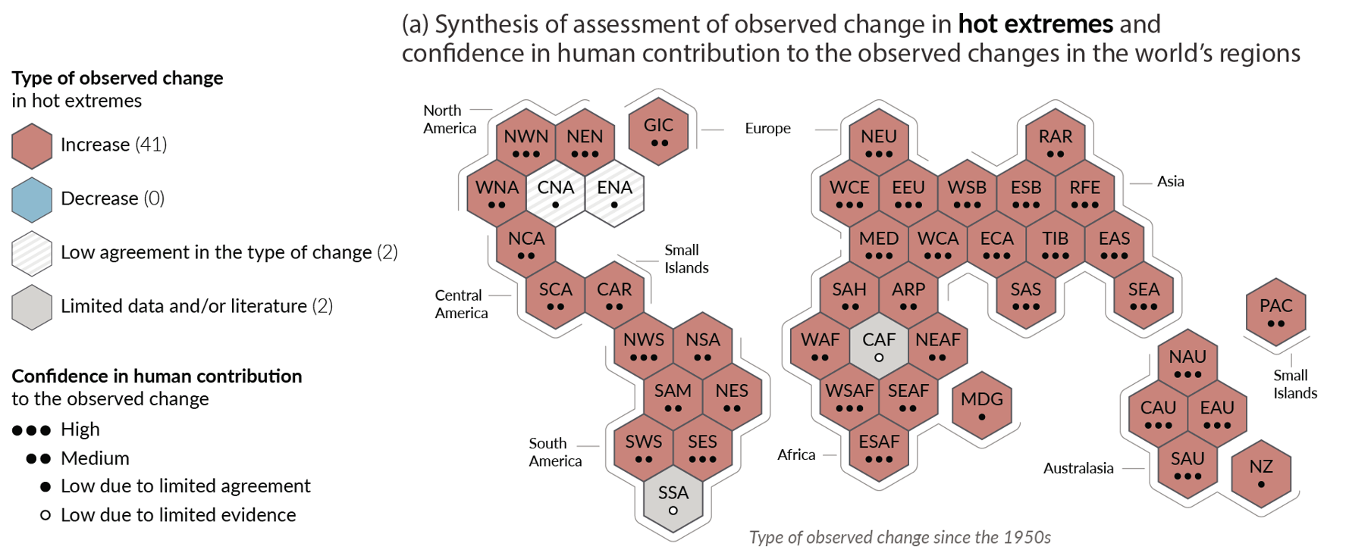
We live in a changed climate!
Notes:
Erin

Slide 8
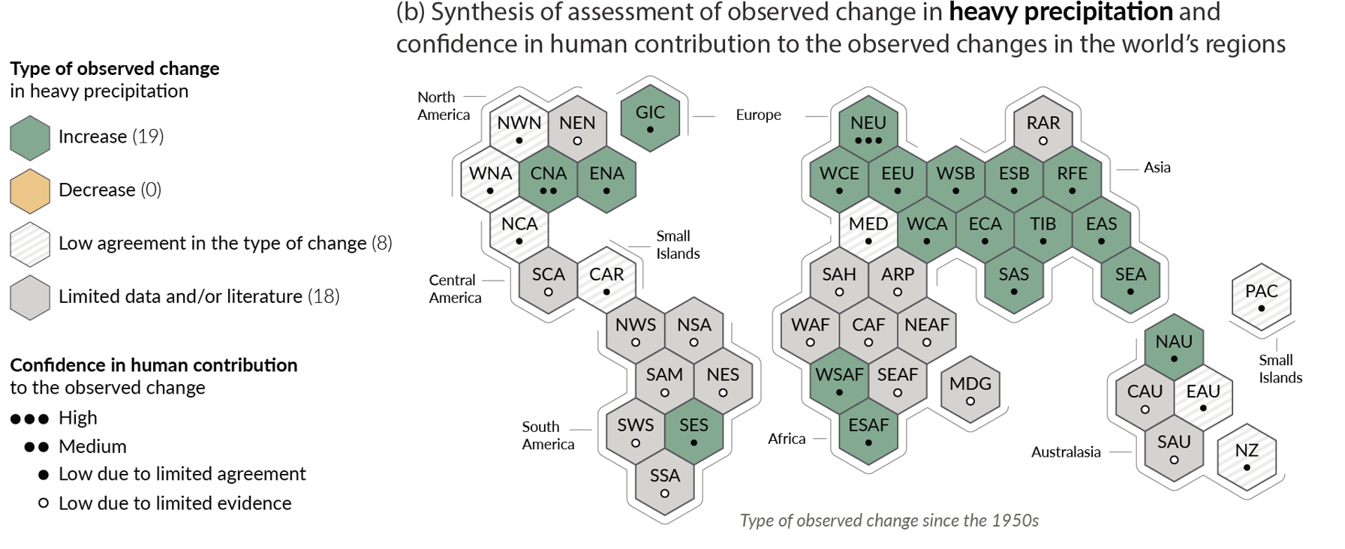
We live in a changed climate!
Notes:
Erin

Slide 9
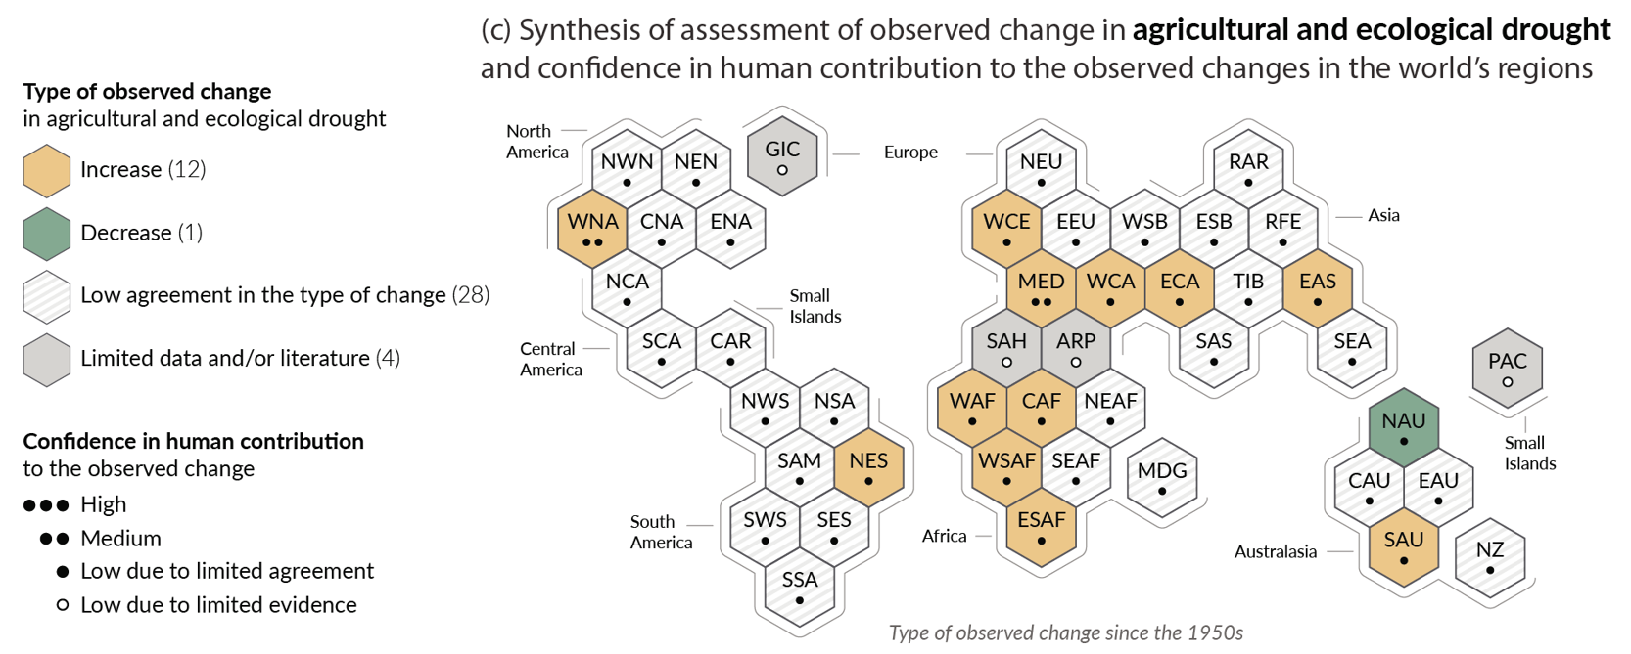
We live in a changed climate!
Notes:
Erin

Slide 10
Trends: Warm and wet events in the summer

Slide 11
Trends: warm and dry events in the summer

Slide 12
Trends: cold and wet events in the fall

Slide 13
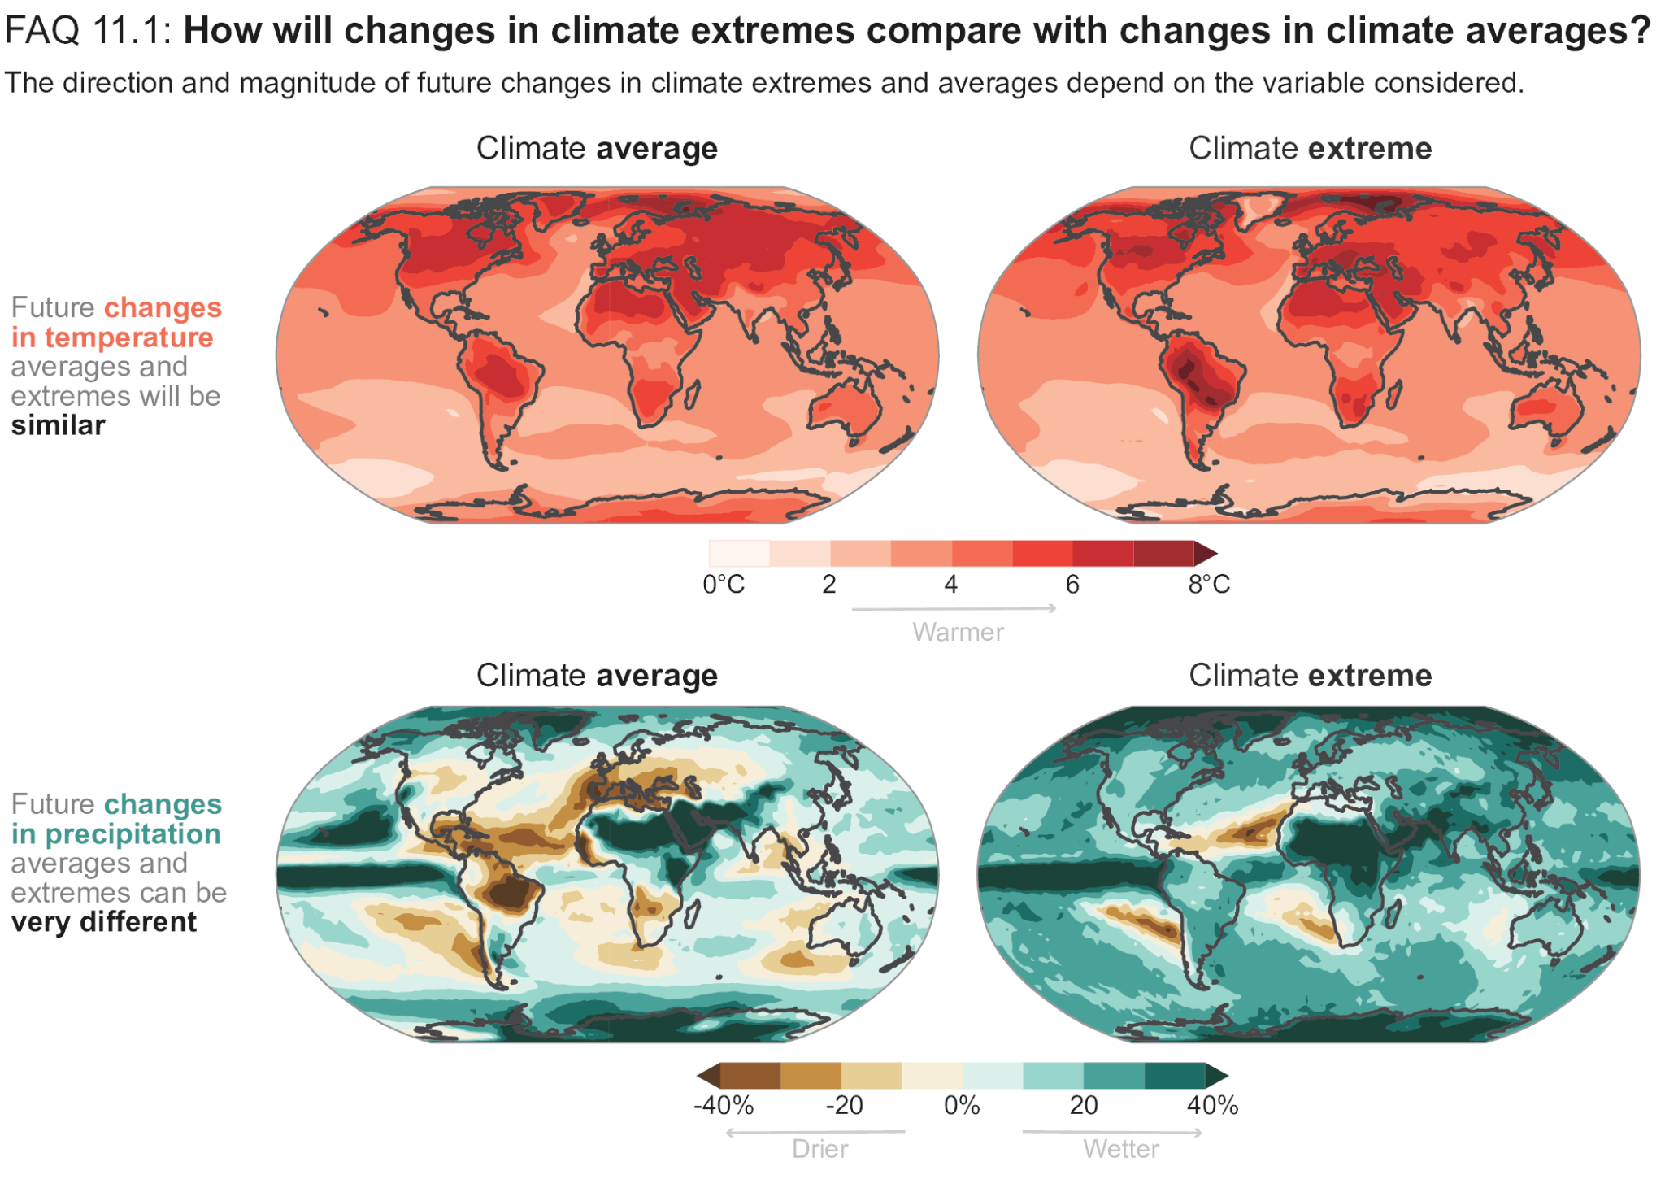

Slide 15
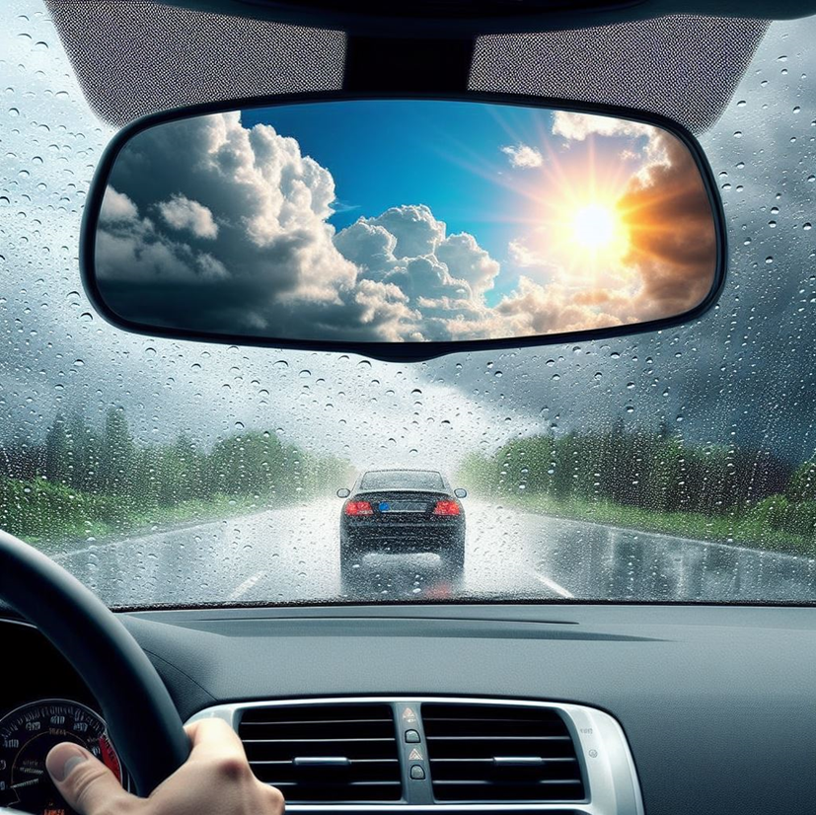

Slide 16
Acknowledgements
Pablo Suarez
Norwegian Red Cross
NASA: Today’s Risk of Extreme Events
National Institutes of Health: Center for Climate and Health glObal Research on Disasters

Slide 17
Acknowledgements

